Slide 1
Round model for dist. algo. From verification to implementation
Cezara Drăgoi
Thomas A. Henzinger
Josef Widder
Damien Zufferey
FRIDA, 24.07.2014, Vienna
Notes:
In the spirit of a workshop, this is very much work is progress: bring some of the methods we developed from theory to practice.
About we are encountering on the way
Trying to make point about the role of verification in that context
Goal is to get debate

Slide 2
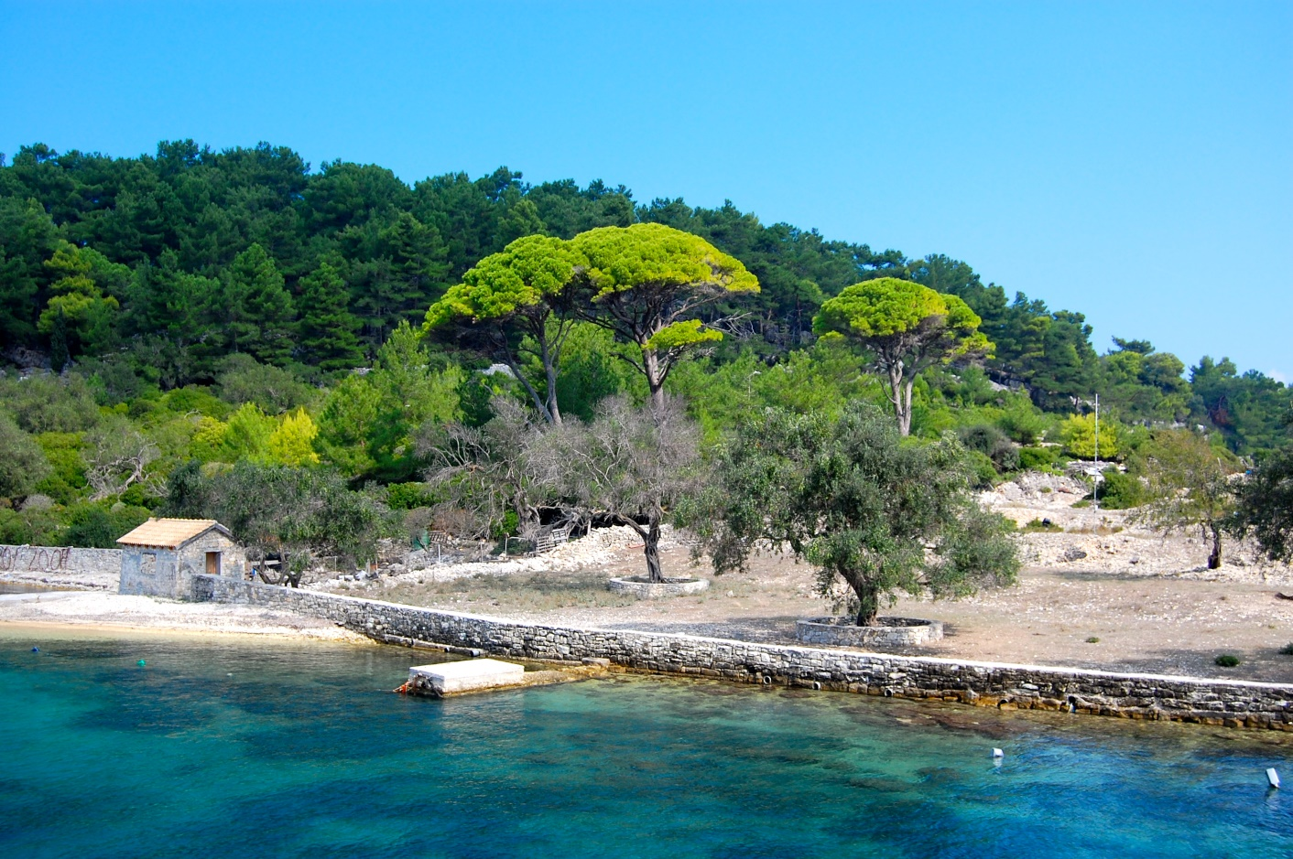
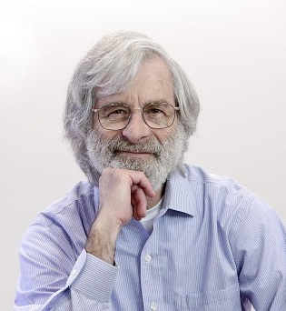
Our journey starts on the island of Paxos …
… where archeologists made an interesting discovery about a parliament system …
CC-BY-SA-NC Matt Taylor Copyright ACM
Notes:
Consensus is just an example: interested in whatever can be proved using the same techniques.

Slide 3
The Paxos Algorithm [Lamport 98]
Prepare
Promise
Accept
Accepted
Proposer
Acceptor
Acceptor
Used at Google (Chubby), Yahoo/Apache (Zookeeper), Microsoft (Autopilot)
Notes:
Prepare: new sequence #,
Promise to accept the proposer for that seq #, reply with last accepted # and value
Accept the value (commit the decision)

Slide 4
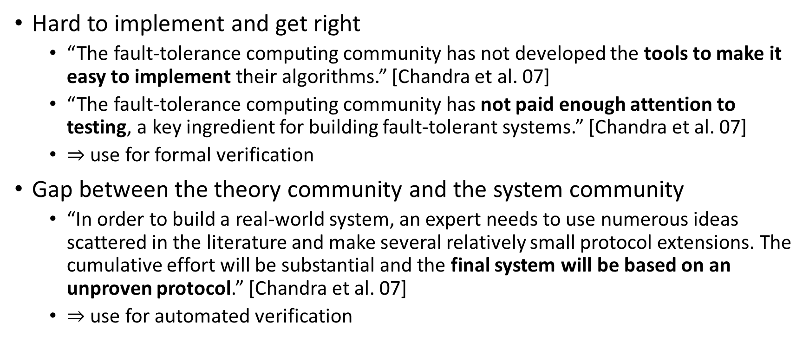
What verification can do ?
Hard to implement and get right
“The fault-tolerance computing community has not developed the tools to make it easy to implement their algorithms.” [Chandra et al. 07]
“The fault-tolerance computing community has not paid enough attention to testing, a key ingredient for building fault-tolerant systems.” [Chandra et al. 07]
$⇒$ use for formal verification
Gap between the theory community and the system community
“In order to build a real-world system, an expert needs to use numerous ideas scattered in the literature and make several relatively small protocol extensions. The cumulative effort will be substantial and the final system will be based on an unproven protocol.” [Chandra et al. 07]
$⇒$ use for automated verification
Notes:
Nothing wrong with proofs of algorithms, but can do more.
Hard to test: fault masking
1st talk: I also don’t like to make proofs, but I like to make algorithm that make proofs for me

Slide 5
Our goals
source code + specifications
verifier
runtime
proof or
counterexample
executable
Notes:
Source and spec in the same language (or very close)
don’t need to learn another tool
lower the barrier of entry

Slide 6
Our goals
Language for verified fault tolerant distributed algorithms implementation
Algorithms in isolation (as published)
Algorithms as part of a bigger system (modified to fit purpose)
Use the HO model to simplify the reasoning
User provides an inductive invariants, then push button
Need a very expressive logic for automation (Cezara’s talk)
Provide an implementation that performs well enough
Show that the overhead of rounds is acceptable
Notes:
Inductive invariant might already be too much.
Fall back to model checking for bug finding, …

Slide 7
Verification Challenges
n
Parametric systems
Asynchrony (Interleaving, delays)
Channels
Faults
…
Notes:
Picking the right model to make verification easier
Parametric systems: undecidable in general
Interleavings: combinatorial blow-up
Channels: undecidable if FIFO, non-primitive recursive if lossy

Slide 8
Communication-closed Rounds
Prepare
Promise
Accept
Accepted
Proposer
Acceptor
Acceptor
[Elrad & Francez 82]: decomposition of algorithm in communication-closed rounds.
[Dwork & Lynch & Stockmeyer, 88] defines round model for non-synchronous models: partial synchrony
Notes:
get ride of the interleavings and channel problem at the same time

Slide 9
Mapping asynchrony to faults
Reasoning in round-based model (partial synchrony)
Implementation in an asynchronous world
Notes:
Reasoning in round-based model (partial synchrony):
Communication-closed rounds (simple model for the channels)
Lockstep semantics (no interleaving, mapping asynchrony to faults)
Heard-of model: map process faults on communication faults
Implementation in an asynchronous world
Asynchrony: no round structure, delays and buffering of messages
Failure detectors to recover some degree of synchrony

Slide 10
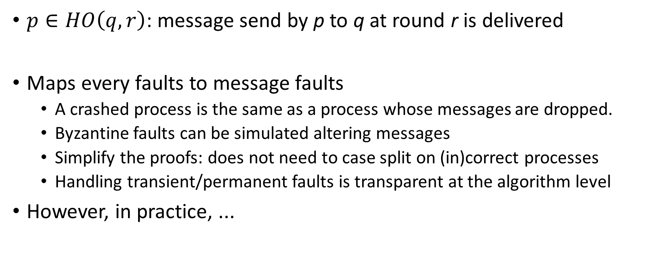
The Heard-Of model [Charron-Bost & Schiper 09]
$p∈HO\left(q,r\right)$: message send by p to q at round r is delivered
Maps every faults to message faults
A crashed process is the same as a process whose messages are dropped.
Byzantine faults can be simulated altering messages
Simplify the proofs: does not need to case split on (in)correct processes
Handling transient/permanent faults is transparent at the algorithm level
However, in practice, ...

Slide 11
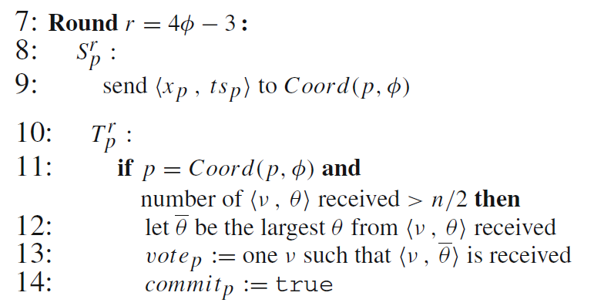
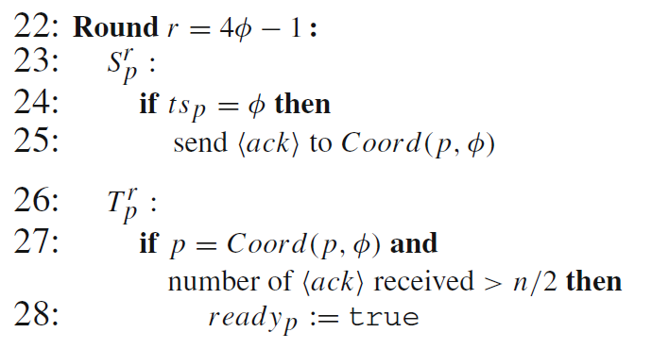
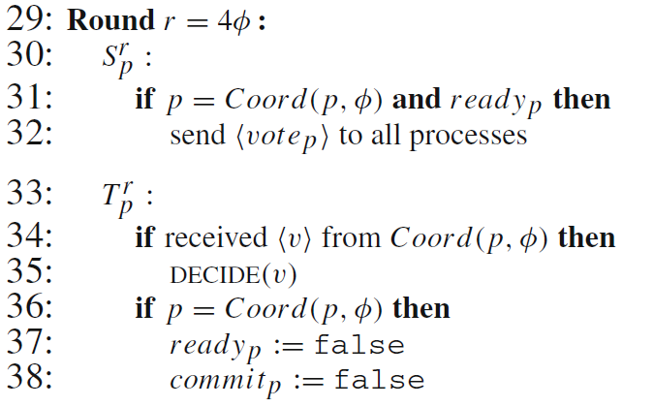
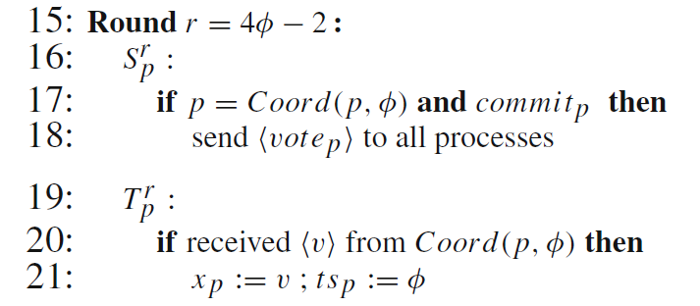
Last Voting Algorithm
Coordinator

Slide 12
Verification

Slide 13
Goals for the verification
Safety and liveness properties
Agreement, Validity, Irrevocability
Termination
User provided invariants
Quite simple
No channels
All the processes have the same PC
Flexibility
Being able to handle a large class of algorithms
Notes:
John Howell about the benefit of writing a spec in TLA.
But TLC did not scale enough to test the interesting cases.
I doubt that the Joe the system guy will use interactive proof assistants
Hope that logic used for consensus is representative

Slide 14









Invariant for the Last Voting example
$$∀i. ¬decided\left(i\right)∧¬ready\left(i\right)$$
$$∨$$
$$∃ v, t, A. A=\left\{ i. ts\left(i\right)>t\right\}∧\left|A\right|>n/2$$
$$∧$$
$$∀i. i∈A⇒x\left(i\right)=v$$
$$∧$$
$$∀i. decided(i)⇒x\left(i\right)=v$$
$$∧$$
$$∀i. commit\left(i\right)∨ready(i)⇒vote\left(i\right)=v$$
$$∧$$
$$t≤Φ$$
$$∧$$
$$∀i. ts\left(i\right)=Φ⇒commit(coord\left(i\right))=v$$

Slide 15
Implementing a system
Notes:
Really understand the complaints of the system guys

Slide 16
Architecture
User application
Algorithm
Round abstraction (Predicate)
Network

Slide 17
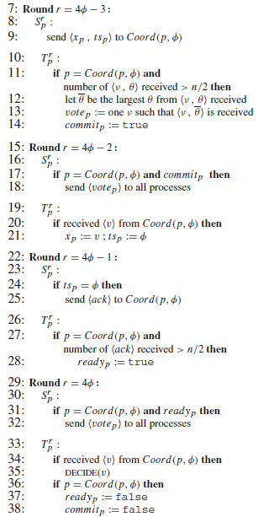
Algorithms
Does not terminate!
Related to recovery procedures
How does it start ?
Praise the benevolent sysadmin
Integration in the user program
Relating the guarantees of the algorithms to the rest of the system.
Notes:
-what are realistic assumptions ?
-formalizing the boundaries of the algorithms

Slide 18
Boundary conditions
Assumes that every replicas runs forever
Starting consensus among some replicas is not so different from a consensus problem itself ?
Difference between not deciding and not knowing we were supposed to decide
What are the assumption you need to get to the point where you can run consensus ?
Sometime you don’t even know how many replicas there are.
… coming from industry people who are running data centers …

Slide 19
Consensus vs Atomic broadcast
In theory, we can solve atomic broadcast by reduction to consensus.
Reverse is also true
In practice, we need another algorithm.
Paxos vs Zab
Zab [Junqueira et al. 11]: atomic broadcast algorithm used in Zookeeper
For performance reason
Share many ideas but Zab is designed to enable quick recovery
Also customized properties (stronger than atomic broadcast ?)
Notes:
-Paxos modified until is became so different that it is a publishable result.
Can we make the tools so this is not publishable anymore ?
-recovery is usually presented on the side
=> Things “on the side” are as important as the main algorithms ?

Slide 20
Same principle, different results ?
Paxos
Last Voting
Notes:
One question we might want to ask
Paxos: a process which is slightly faster than the other might take over and the other will starve.
LV: used in the Paxos setting, it might never make any useful decision (always decide “empty”)
Paxos: only the proposer has one value at the beginning
Last Voting: everybody proposes a value at the beginning

Slide 21
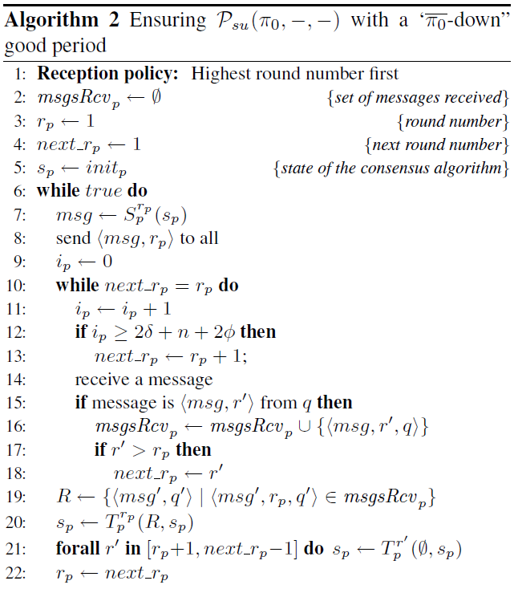
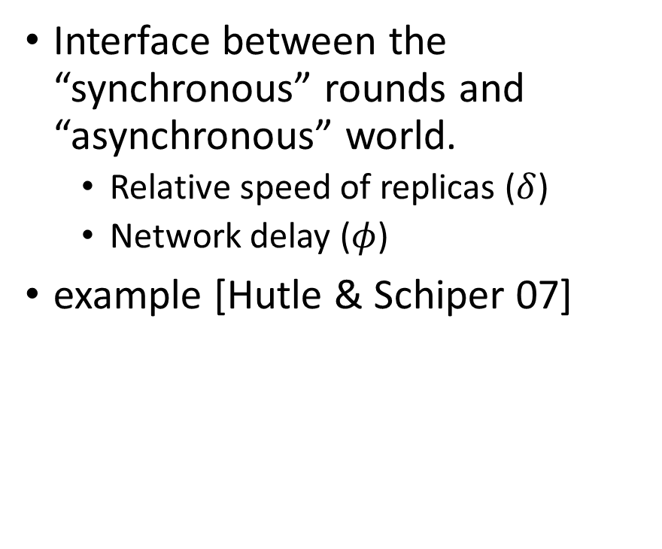
Predicate
Interface between the “synchronous” rounds and “asynchronous” world.
Relative speed of replicas ($δ$)
Network delay ($φ$)
example [Hutle & Schiper 07]
Notes:
Also link to the fault model of the channel
Not quite how you would implement it:
-busy waiting
-does not deal with message duplication (happens over UDP)

Slide 22
Related work
TLA+ [Lamport 91] that comes with a model checker and proof assistant [Chaudhuri et al. 08]
Isabelle formalization of algorithms in the HO model [Charron-Bost & Merz 09]
Mace [Killian et al. 07] a DSL for distributed systems, comes with a model-checker.
Declarative networking: (logic) programming [Loo et al. 06] and verification [Wang et al. 09]
Notes:
TLA/TLC: sometime less is better, does not run
Mace: (+) runs and verif together, (-) bounded MC

Slide 23
Summary
Implementing a correct fault-tolerant system is hard:
We have the tool to help:
ATPs, SMT-solvers, model-checkers, …
Where to position ourselves ?
Verification/programming abstraction: more tractable vs closer to real systems
Formalization of the boundaries of the systems
Start/stop
Interactions between main algorithms and recovery procedures
Customization of algorithms and properties of the system which uses the algorithm

